Slide 1


Welcome to
Fourth Grade!
2025-2026
Bowden, Northcutt, and Hertzka

Slide 2
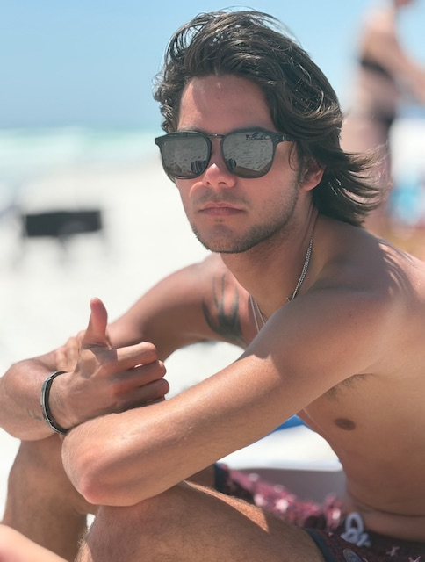
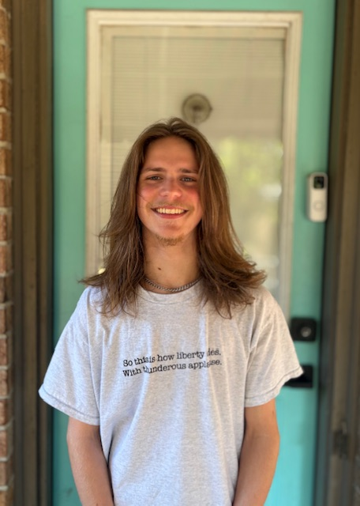
Ms. Bowden
•starting 7th full year at Richland Elementary
•Bachelor’s in Education, Teaching All Learners certified K-8, modified special ed. K-12
•I have a 21 year old son, Brock, at Moore Tech, graduating in December and a 17 year old son, Noah, a senior at Houston High School

Slide 3
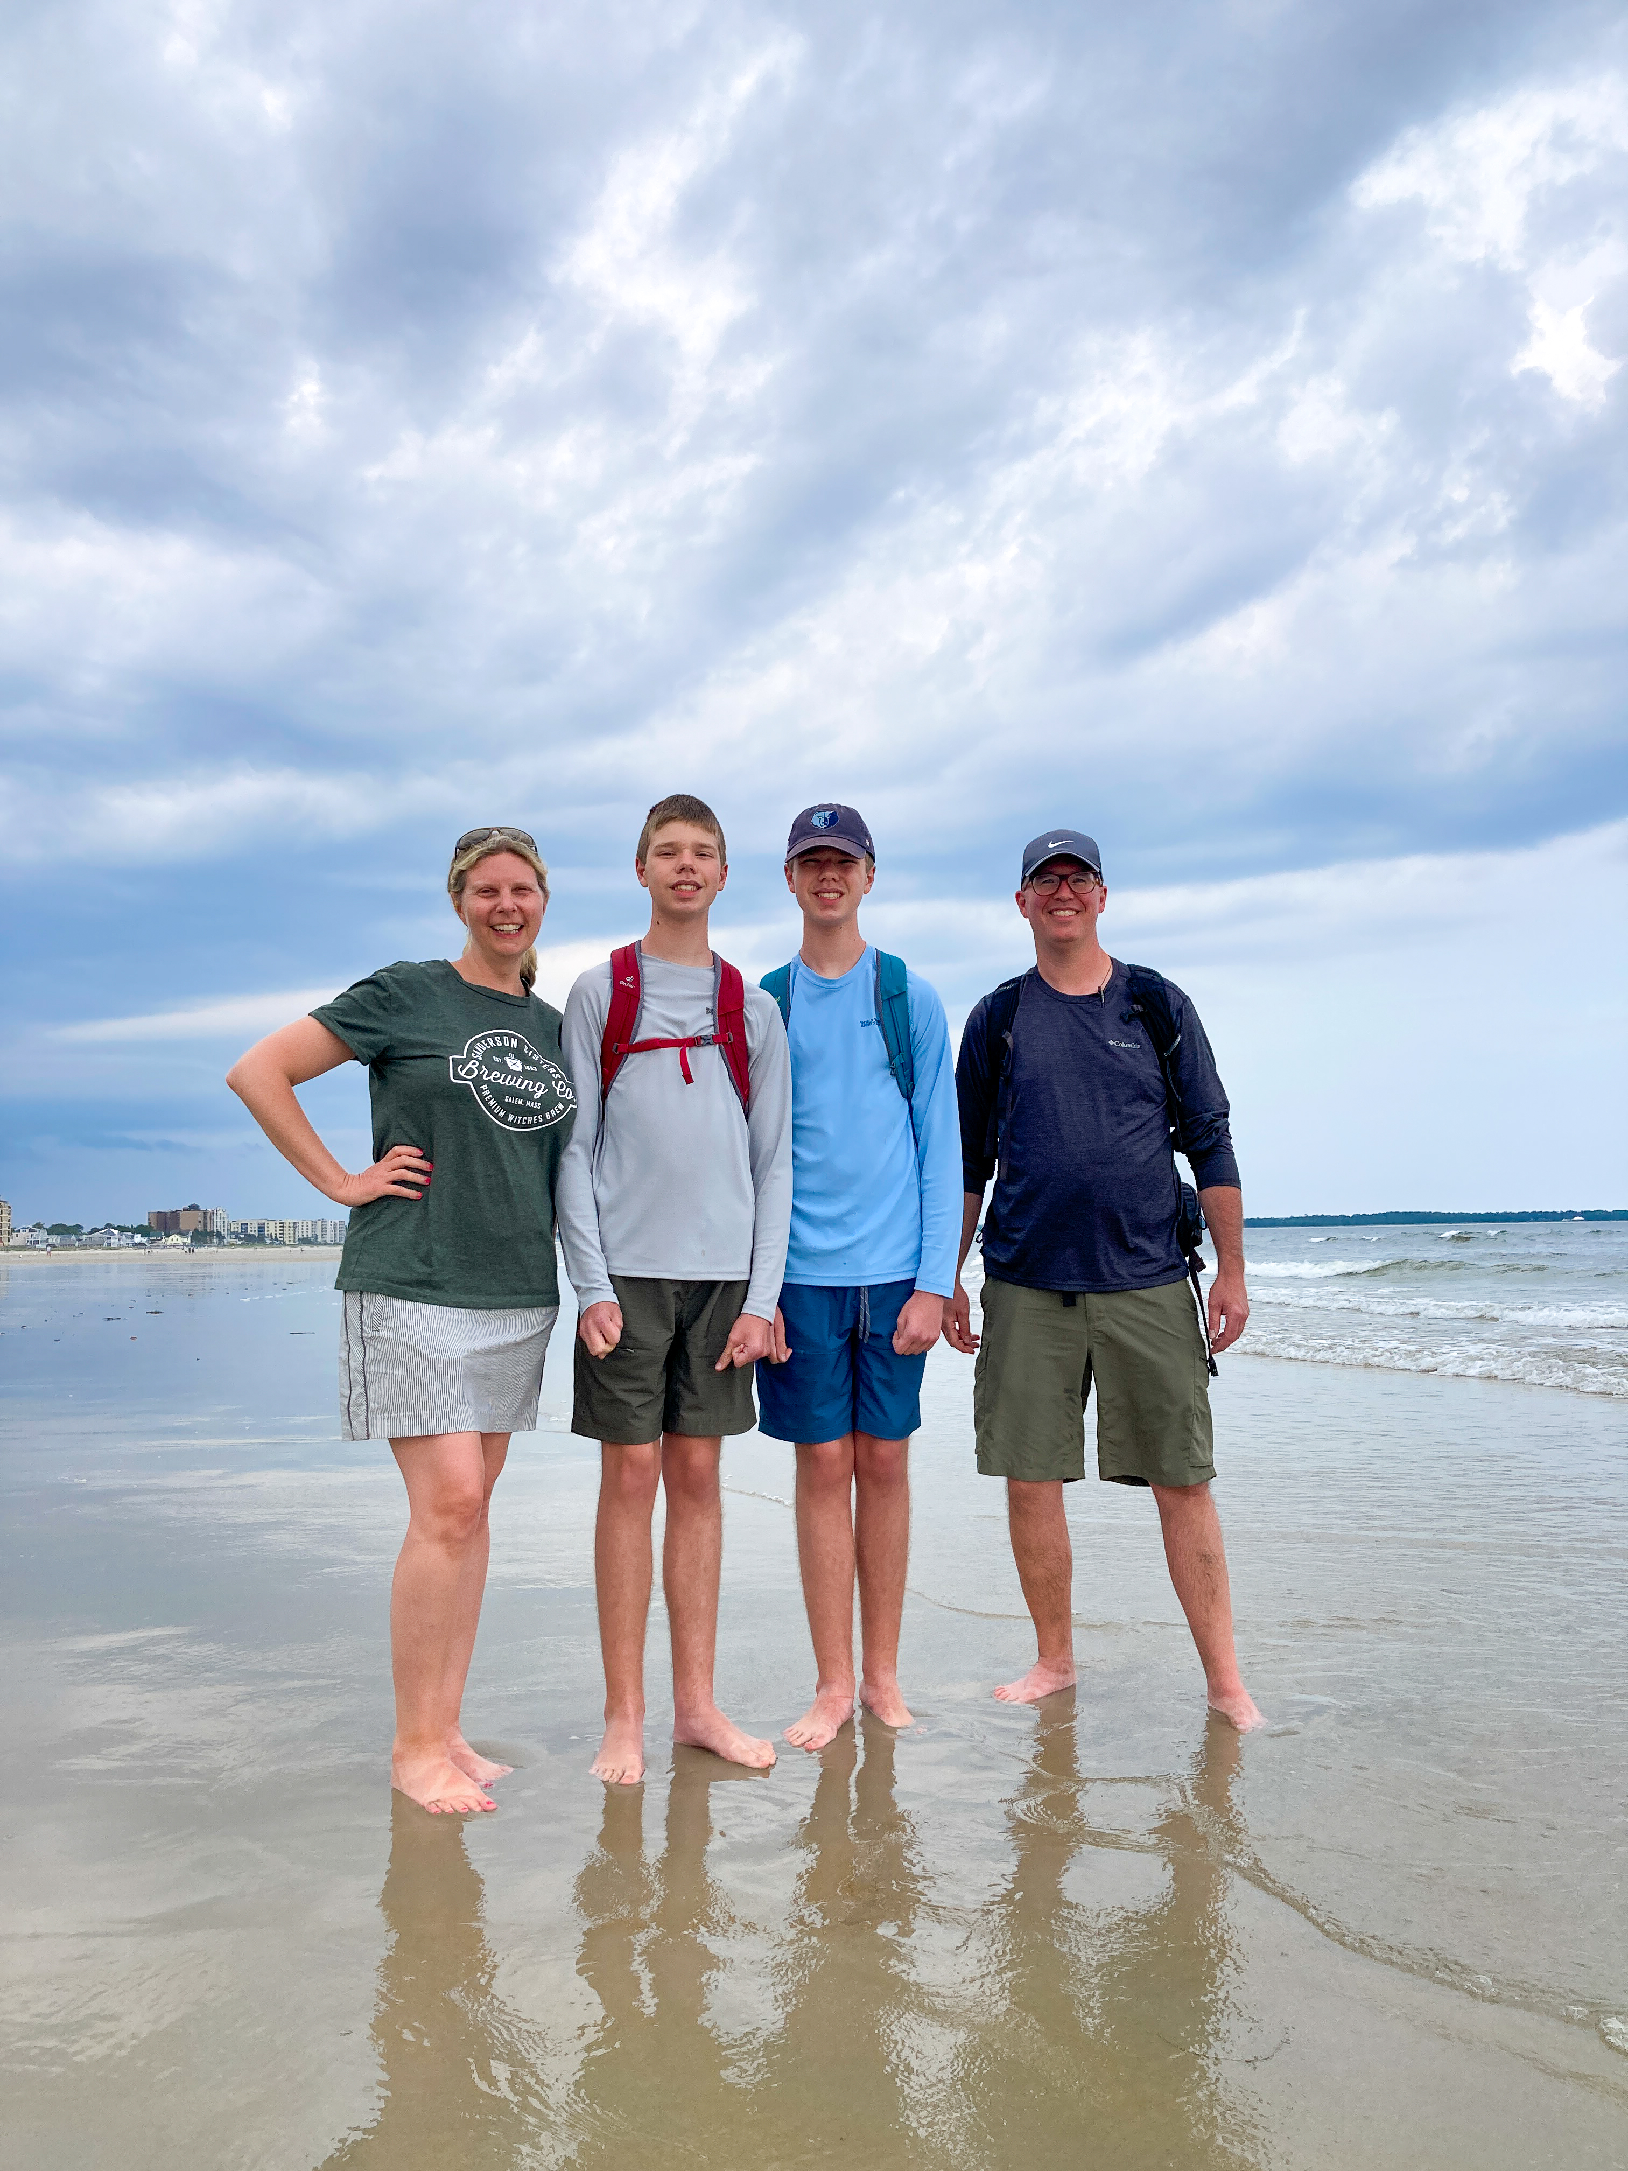
C. Northcutt
I have been teaching since 2002
Alumni of the University of Memphis (Go Tigers!!)
Bachelor of Science in Education, Endorsement K-8
Master of Science in Education, Reading K-6
Master of Science in Education, Mathematics K-6
I have identical twin boys named Miles and Alex.

Slide 4

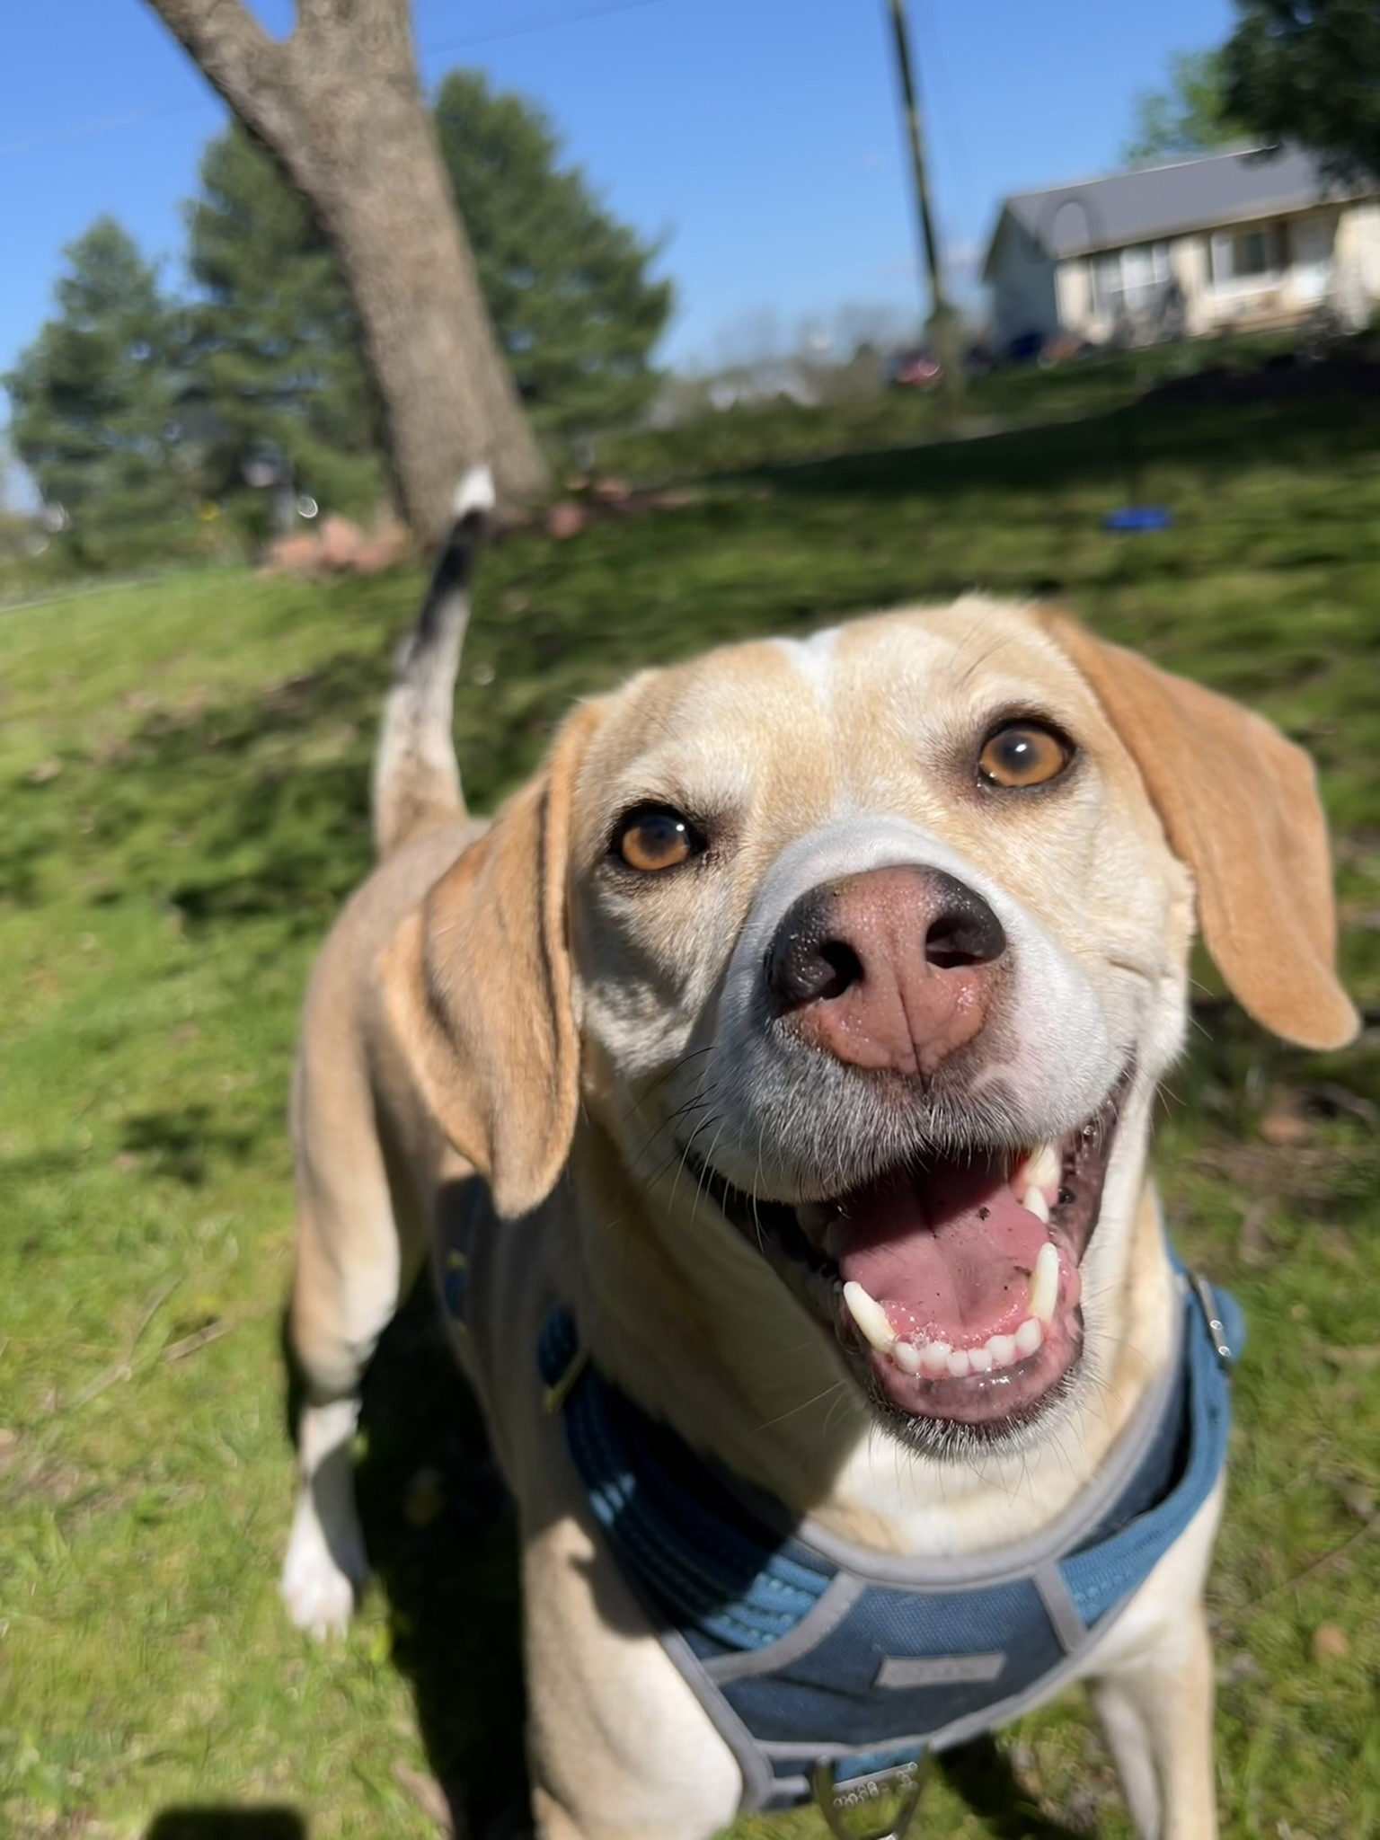
Ms. Hertzka
B.S.Ed. - from Union University
Beginning year 3 of teaching
Loves manatees
I have a rescue beagle named Duck 5 years old.
I love to travel

Slide 5
Weekly Communication
Newsletters containing lessons for each subject will be posted on our websites by Friday afternoons. Each website will contain the SAME newsletter.
Newsletters can be found under “Updates” on each webpage.
Bowden's Webpage
Hertzka's Webpage
Northcutt's Webpage
IMPERATIVE: Please ensure you have a working email address in PowerSchool. Reach out ASAP if it is not current.

Slide 6
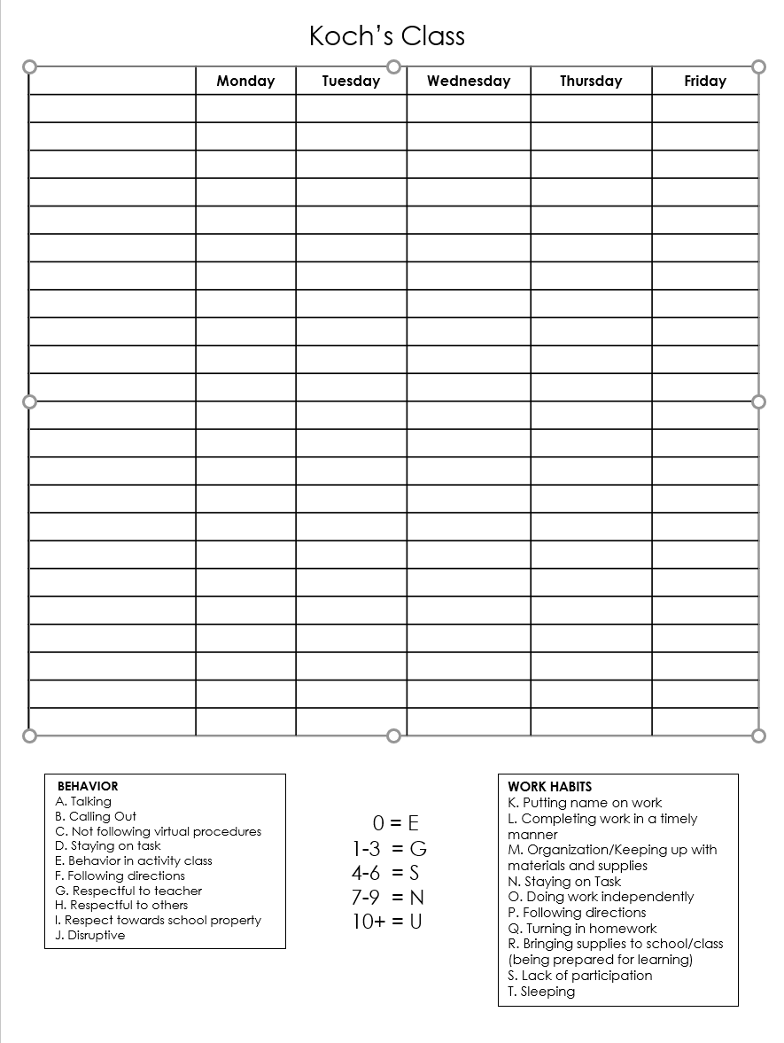
Behavior
We will follow MSCS and Richland behavior guidelines. 4th grade dictates this by the Richland's Fabulous Four.
We monitor classroom behavior daily. We use a clipboard that follows students to each class. We can then notify you if there is a behavior issue that occurs during the day.
The following chart will allow us to keep track of conduct/work habits throughout the quarter.

Slide 7

Personal Wireless Communication Devices

Slide 8
Attendance/Tardies/School Hours
School Hours: 8:15-3:15
If your child is going to be absent for several days, please let us know so that we can gather make up work. We will need ample notice to gather materials.
When your child returns to school, please send an excuse note/doctor note.
Make up work is the responsibility of the student!
Dismissal: Please pick up your child at 3:15. We often have meetings scheduled at 3:30 that we must attend.

Slide 9
4th grade Schedule
RECESS occurs during Sci/SS.
We will operate on an A/B schedule. See homeroom websites for specifics on schedules.
ENCORE: Varies by teacher
8:00-8:15: Good Morning (Homeroom check in)
8:15-9:00: BOOST
9:05-10:35: Block 1
10:35-11:25: ENCORE
11:30-1:00: Block 2
1:00-1:30: LUNCH
1:35-3:00: Block 3

Slide 10
SNACKS and WATER BOTTLES
Due to our late lunch, students may bring a healthy snack! (DRY)
Goldfish, pretzels, string cheese, apple sauce pouch, etc.
We will not allow candy, Takis, and full lunch items (ex: sandwiches)
We have working water fountains in each hallway. Students may bring water bottles to school. Each class will have specific water bottle procedures. Please no open straws (i.e. Stanleys)

Slide 11
Conferences
Email
If your concern is minimal, you are welcome to email at any time. We will respond within 24 hours.
bowdene@scsk12.org
northcuttcr@scsk12.org
hertzkam@scsk12.org
Please be mindful that emailing about an assignment after school hours may not receive a response prior to the next day.
We are generally available in the mornings (10:35-11:15), except Tuesdays.
Dependent upon schedules, after school meetings may take place.
If your concern is specific to reading, please contact Ms. Northcutt. Likewise, if your concern is specific to science/social studies, reach out to Ms. Bowden. Math concerns are directed to Ms. Hertzka.
We are happy to schedule conferences with you when you have a concern to discuss. You do not need to wait until parent-teacher conference night. (Thursday, September 11th )

Slide 12

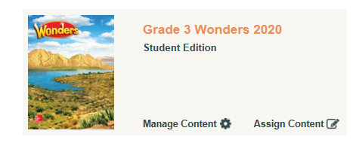
Curriculum: WONDERS

Slide 13
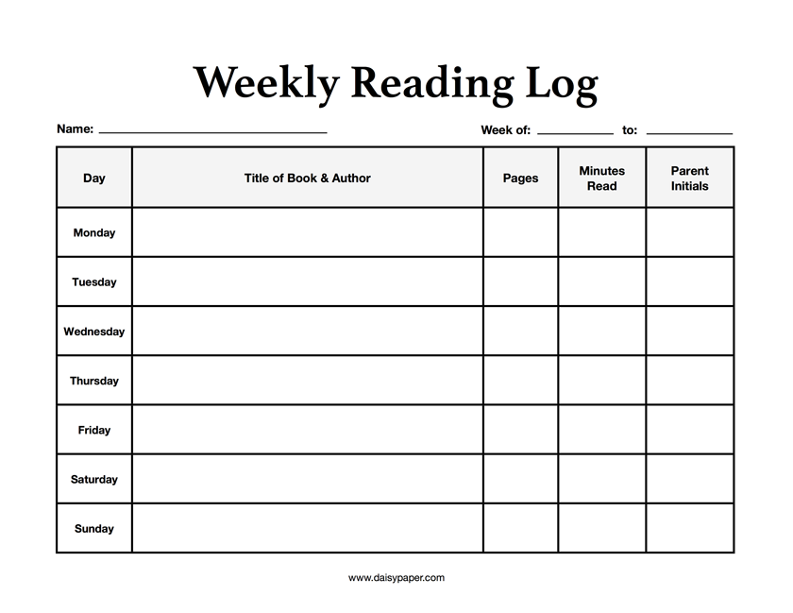
Reading Log

Slide 14
Curriculum: enVision Math
Math content will be taught based on TN State Standards. I will use Envision Math and teacher created resources to guide instruction.
Study guides will be provided prior to every test! Use them!
Please be mindful of negative perceptions/ attitudes surrounding math. It is most observed by children and they carry it into the classroom. Every child has enormous potential, and we need to do everything to maximize it!

Slide 15
Math Facts
I give a math facts quiz every Friday. It will have 20 problems and students will have 2 minutes. We will begin with the 2x math facts, then move to the 3x facts, and so on….
Math facts will be entered as project/portfolio grades which only account for 5% of the final average.
Students with 504s/IEPs will be given time and a half as noted in the plans. (if deemed necessary!)
Homework is given on Monday and is due Friday.
BASIC NECESSITY in math: Pencils and the courage to be wrong.

Slide 16
Science/Social Studies
Weekly quiz
Writing in Social Studies
Homework- will only be sent if classwork is unfinished or student has makeup work.
Reasearch!

Slide 17
SCS Grading Policy
Homework: 5% (minimum four grades)
Class Participation: 5% (minimum four grades)
Classwork: 40% (minimum four grades)
Projects, portfolios, or presentations: 5% (minimum one grade)
Tests: 45% (minimum four grades)
10 point grading scale

Slide 18
Homework
Homework is a required category in SCS grading policy. We must include a minimum of 4 homework grades per quarter. Homework comprises 5% of the final average.
Homework is graded for completion, not accuracy.

Slide 19
Viewing Grades
PowerSchool is available to all parents. This is the BEST way to monitor student grades. We try to update PS often.
Wednesday folders will also contain graded papers. Please check your child’s Wednesday folder and review graded work. SIGN that you have reviewed the work. We need all work that is below a 70 to be signed and returned. Keep everything else, please!
PLEASE make sure your email addresses are correct in PowerSchool. We send updates via email.

Slide 20
Birthdays
Healthy Foods Policy prohibits the sharing of treats. We are NOT allowed to pass out cookies, cupcakes, candy, etc. for student birthdays.
Invites: If your child is having a birthday party, please send out invites privately and/or electronically. If invites are sent to school to be dispersed, everyone must be invited.

Slide 21
4th grade Field Trip to Discovery
4th grade students go to Discovery Park of America in Union, TN in May! We encourage anyone to chaperone (no limit). However, ALL CHAPERONES must undergo a level 3 background check. This requires fingerprinting at the board.
This trip is a bit pricey, so plan ahead! (about $70)
We take a charter bus, not a school bus, which makes it more expensive.
It is encouraged to go ahead and start the level 3 background check process early! It does take some time to get approved!!!!

Slide 22
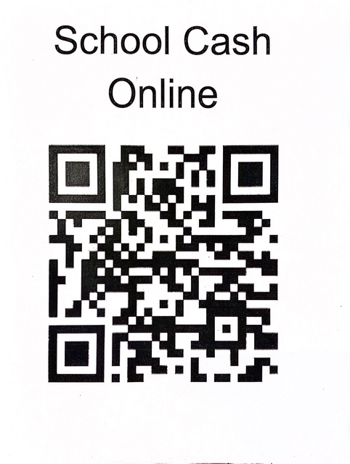
School Cash online

Slide 23
Arrival and Dismissal Procedures
Arrival
Students may arrive at school no earlier than 7:45
Please ensure that your student is coming into the correct door.
4th grade enters where we dismiss.
Dismissal
We will dismiss under the East overhang at 3:15.
Please arrive by 3:10 to avoid traffic tie-ups.
Please alert teachers of any changes by 10:00 am if possible.

Slide 24
Cross Country
Cross Country registration has started! If you are interested, there are forms in the office.
Final Deadline to register with all forms turned in : September 3rd
Last day to order XC spirit wear: August 25th
First practice: Thursday, August 21st (must have all forms turned in to participate in practice)
Williamsonmf@scsk12.org

Slide 25
Uniform Policy
Shirts- white, grey, red collared shirts OR Richland Spirit Wear shirts-
No Field Day shirts
Shorts/Pants/skirts- Khaki, black, navy- please check length
Dresses- white, red, gray
Jumpers-navy or Khaki
Jackets- black ,navy, red, grey- no logos or writing
Students are allowed to wear Spirit Wear shirts that say Richland through the week. They are NOT allowed to wear Richland Field Day shirts or sweaters with logos or writing on them unless it is Richland.

Slide 26
Honor Society
Teachers will be submitting students for consideration of National Elementary Honor Society in Quarter 3.
Only students with cumulative A/Bs, Es in conduct, and no more than 5 unexcused absences will be considered. (not a rolling invitation)
Students will be inducted at the end of 4th grade and will continue as members through 5th grade (if all above criteria are met)
During 5th grade, the honor society will be a service organization, with service projects throughout the school year.

Slide 27
Communication! Download Class Dojo app!
Communication will be through Class Dojo. All families should have automatically been added. If you have not accepted, please do so or if you have not been added, please reach out to your homeroom teacher so that we can send to you.
We will not be inundating you with emails, so please be sure to read the ones we send thoroughly! Thank you!

Slide 28
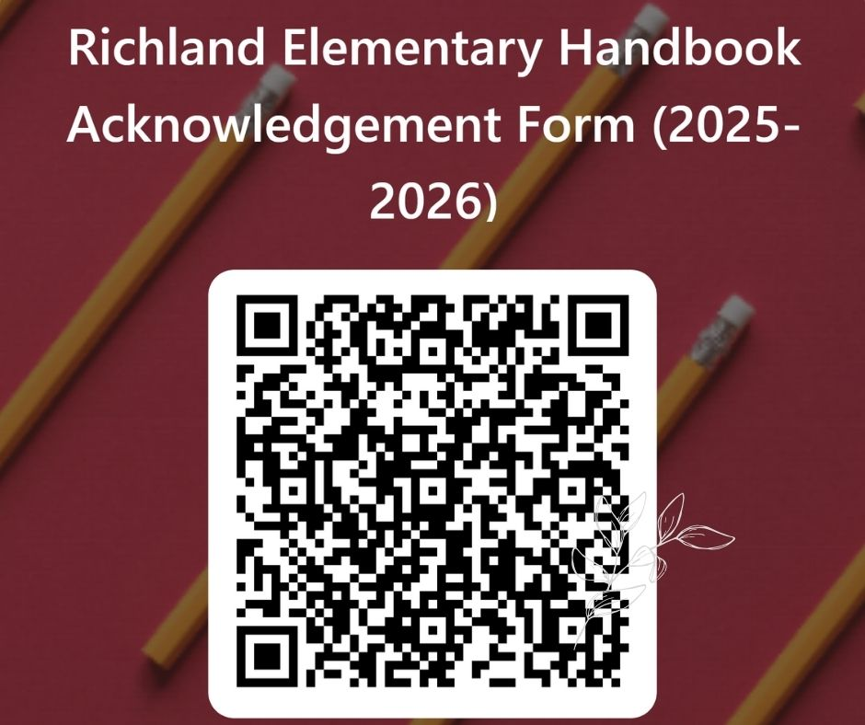
School handbook acknowledgement

Slide 29
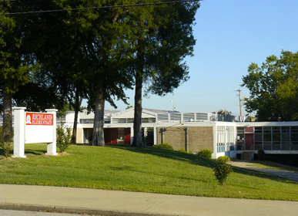
Contact
Erin Bowden
bowdene@scsk12.org
Courtney Northcutt
northcuttcr@scsk12.org
Madison Hertzka
hertzkam@scsk12.org

Slide 30

Questions??

